Slide 1
GIT Basic Training
Version Control with GIT
Ciprian DIMA
Adrian MOGOI

Slide 2
Content of this training…
Theory…
SCM & Version Control
Basics of Version Control
What is GIT?
Decentralized Version Control System?
Getting started – GIT Basics!
Setting up the local environment
On LINUX
On Windows
The initial setup
Hands on GIT!
Create your own repository
Setup your local environment
Create a change
GIT help
Notes:
Greetings
Introducing yourself
Round table – Git/SCM Skills
Presenting the agenda of the training
To agree on the start date, end date and the lunch time
Presenting the training content (table of content)
Explain the rationales behind the each item of the table of content

Slide 3

SCM & Version Control
What is Version Control and SCM?
Why is Version Control essential for Software development?
Evolution of files in a controlled way
Backup and Restore
Sharing the changes
Track changes
Branching and Merging
Tracking History
SCM - acronym for Software Configuration Management – to control the evolution of software systems
Defined in IEEE it highlights operational aspects of CM (Configuration Management):
Configuration identification
Configuration control
Status accounting
Audit and Review
Environment management
Process management
Build management
Access control
Notes:
Justification: to explain SCM and the purpose of VCS for the newbie. To show what is the differences also between SCM and VCS.
To remind the context of VCS which is the SCM and gives some references of other configuration managements.
To explain the purpose of VCS and why it is essential
To have a specific on tracking history because it describes how the software has evolved and how has done the evolutions.

Slide 4

Basics of Version Control
Why do we need Version Control?
GIT is not a Software Configuration Management Software!
GIT is a widely used source code management system also called distributed revision control system.
Keeping copies of files and altering has downsides like:
Organization of files
Roll back to older versions
Who did I receive this version
Why has this change been done
Notes:
For newbie, to explain what is a version control system. For that, you can take the example of word document for instance.

Slide 5

GIT
A short history…
From 1991 till 2002 no VC tool was used to develop the Linux Kernel.
In 2002 Linus Torvalds and the Linux community worked with BitKeeper VC.
In 2005 BitKeepers free-of-charge status was revoked; a new tool was needed.
Linus starts working on his own VC Tool and calls it GIT – a decentralized Version Control Tool.
The requirements:
Speed
Simple design
Strong support for non-linear development
Fully distributed
Able to handle large projects
A major difference: DVCS to CVCS
A CVCS is a centralized Database for the VC System in use. All collaboration must go through the central storage. Single point of failure and bottleneck when the network performance from Client to Server is weak.
DVCS is a decentralized Database which is received by each developer. All history and versions are locally available. Removes the Server as the single point of failure as well as the network as a possible bottleneck.
Notes:
The history of Git explains why Git is as it is today. So it is a good way to explain the big features of Git.
Git has been developed by Linus Torlvads, which can be used to prove the reliability of Git.
Git is not so new and it has already 10 years.
To insist on the major paradigm change between CVCS and DVCS.

Slide 6



Decentralized Version Control System
DVCS vs. CVCS
Centralized Version Control System
Decentralized Version Control System
Notes:
A good illustration is better than 1000 words
Of course during the animation, the trainer must give detailed explanations:
A central server where all the source code is located
The central server goes down (, which can happen)
All the designers will be blocked

Slide 7
Decentralized Version Control System
Advantage and Disadvantage
Advantage
Designers can work independent from server infrastructure on the local database.
Allowing easy draft coding, changes without impacting others.
No single point of failure.
Very fast communication between Client and database.
Disadvantage
Lack of control.
Initial pull for large repositories can be slow, but there are ways to narrow down what GIT is pulling.
No Backup of the local Database.
Exchange of information between local Databases must be coordinated – workflow definition.
Notes:
Here the topics:
Responsiveness
Efficiency
Redundancy
Hidden topics:
What does it mean a central repo where all the repo are identical
Repo owner
Fork workflow

Slide 8
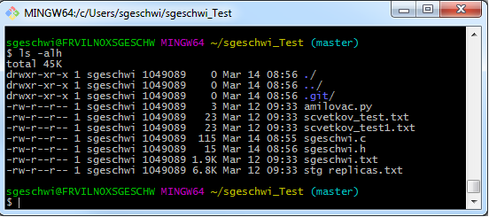
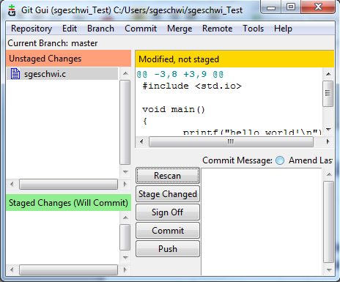
Getting started – GIT Basics!
Command Line & GUI
GIT is a command line tool developed for Linux Kernel designers originally.
It is easy to use and to understand.
For Windows-Users GIT provides a graphical interface
The Windows GUI though does not provide as many command options as the command line.
Communication supports Client-Server if configured in the environment, although most of the day to day user operations are done local on the user host.
Notes:
First contact, Git CLI
Git is a command line interface
Graphical integrations exists: Git extension, IDE integration, Tortoise Git, …

Slide 9
Getting started – GIT Basics!
The GIT Database
How GIT stores data is different from other VC Systems
GIT stores “snapshots” of the file system instead of single versions of elements under version control.
GIT operates mostly only on your local system – erasing possible bottlenecks (network or server) during the work.
GIT provides integrity with checksums (SHA-1 hash).
GIT generally only adds data to the repository
Changes over time…
Version 1
Version 2
Version 3
Version 4
Version 5
File A
A1
A1
A2
A2
File B
B
B
B1
B2
File C
C1
C2
C2
C3
Notes:
Understanding what is a version, named a commit later on
Explain also how a commit is built: only file changed are in the commit, for unchanged files a pointer is used (dotted lines). Important: the changed file is completely stored in the commit. That explains why the binary are to be avoided.
This definition of a commit is behind the efficiency of Git: rollback is easy, an atomic change is meaningful in Git, makes the merge operation easier
It is also why Git is not efficient with binaries.
It justifies also why linear history is recommended: a tool is built step by step with each step being meaningful.

Slide 10
Getting started – GIT Basics!
GITs Repository
The GIT repository… in short called “repo”
The place to store our data and the history for all changes.
The repo consists of 3 parts:
Working directory / the place to do changes
Index / the staging area to prepare the commits
Database / all versioned data and history of the project
Working
directory
Index
Database
Notes:
Here we introduce the main concepts used to work with Git:
Working directory is where we develop a new change
Stating area is among the changes we made, what we want to keep for in the next version (commit)
It means that a developer may work on several changes in the same file or on several files
Some changes, because they are not ready, are not to be committed (probably next time)
Some changes are done, they can be committed
Where the commit is stored once created

Slide 11
Getting started – GIT Basics!
File states in GIT
3 States in GIT for your repo…
Modified – the state of a changed/added file.
Staged – marked a changed/added file to be taken into the next commit.
Committed – the changes have been saved to the local GIT database.
The GIT (./.git) directory stores the metadata and the objects within the GIT database.
The Working directory is the single “checkout” of one version of the repo.
The Staging Area (also called Index or Cache) is a file storing information for the next commit.
Working Directory
Staging
Area
.git Directory
Checkout the Project
Stage Fix
Commit
Notes:
Several interesting things to understand:
There is only one working directory per version in Git!!! You cannot work checkout simultaneously within the same repository 2 versions!! One version at a time or 2 repo are required.
A change has several states and there is Git command for updating a state
Some explanations of what we find in the folder of a Git repo.

Slide 12
Getting started – GIT Basics!
GITs internal objects
File deltas in GIT? – No!
GIT does not work with deltas of files like other VC Systems.
It stores the information “as it is” in its Database.
Any state can therefore be recovered easily even if pervious “snapshots” may have been removed.
GIT doesn’t remove versions.
*GIT doesn’t “rewrite history”…
The GIT Object Database stores 4 different objects:
Blob
Tree
Commit
Tag
Tag
Commit
Tree
Blob
* More about rewriting history later
Notes:
A detailed explanation of slides 9.
How a git commit is built.
It is not required for using Git: purely informational to understand the mechanics behind a git repo.
But, for trainees who want to understand more Git, it is a mandatory input.
http://alblue.bandlem.com/2011/11/git-tip-of-week-git-bigjobbies.html
https://git-scm.com/book/en/v2/Git-Internals-Git-Objects
Git keeps object files in database. It is not keeping content.
.git/objects
=> for a file is kept as content using SHA1 hash.
The first 2 letters from hash = subdirectory and the rest represents the content of the file
Example:
find .git/objects -type f => display all files objects
# find .git/objects/ -type f | grep "9c/417"
.git/objects/9c/417edb3b1142b5f3698e0f567e9e05e423577c => the hash is : 9c417edb3b1142b5f3698e0f567e9e05e423577c
#git cat-file -t 9c417edb3b1142b5f3698e0f567e9e05e423577c => show the type of object :blob (binary large object), commit or tree -t = type
#git cat-file -p 9c417edb3b1142b5f3698e0f567e9e05e423577c => show the content of the object
#git rev-list --all --objects => list all objects from a repository
tree = object to store filenames
In Git, all the content is stored as tree and blob objects.
#git garbage collector = git gc
git gc can work out what objects are no longer reachable from any reference, and ultimately prune them from the record.
#git cat-file -p master^{tree} => master^{tree} syntax specifies the tree object that is pointed to by the last commit on your master branch

Slide 13
Getting started – GIT Basics!
Blob, Tree and commit
A Blob object in GIT:
Stores the compressed content of a file.
A Blob by itself has no meaning.
Blobs need references to originating files or any other object.
The Tree object in GIT:
A Tree is comparable to a “directory” within a file system.
It contains a list of Blobs and possibly a list of other Tree objects.
Trees are pointers recording containing Blobs or Subtrees.
A GIT Commit includes the following:
Timestamp
Author
Committer
Log Message
Identities of previous Commit(s)
Snapshot of a directory tree
C0
C1
C2
Notes:
Here it is highlighted the implementation of what was illustrated in slide 9.
. Blob maps with a file
. A tree with a folder
The most important part is the content of a commit:
Author of the change is not necessarily who build the commit: here we have to insist about that difference
A simple change of the creation time changes the commit!!!
The fact that the parent commit is given enables to build the history : it is the building block of a git history
Note: that in case of merge there are 2 parents
Of course the content itself

Slide 14


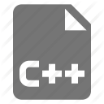
Getting started – GIT Basics!
GIT Objects in relation
Commit
root
Tree
root
docs
src
Tree
Tree
docs
src
Blob
Blob
Blob
docs/README
src/foo.cpp
src/bar.cpp
docs/README
src/foo.cpp
src/bar.cpp
Notes:
The mapping is illustrated.

Slide 15
Getting started – GIT Basics!
Tags and References
Metadata of Tags in GIT on Commits
The Tag name
The person which tagged
The Tag description
Tags are used as containers to reference a Commit.
Common use of a Tag is to reference Release data with a more meaningful description than a Commit SHA-1
3 kind of Tags exist:
Annotated Tags
Signed Tags
Lightweight Tags
A REF is an indirect way of referring to a Commit. Considering a Ref like a user-friendly alias for a Commit hash. This is GIT’s internal mechanism of representing branches and tags.
Refs are stored as normal text files in the .git/refs directory.
HEAD is a Reference for example. It points to the current location which is checked-out, e.g. a Branch.
Reference
Tag
Commit
Commit
Notes:
Quick introduction to Tags and the 3 tag types
We have to insist on the purpose of tag which is exactly the same as under SVN: a parallel with SVN is helpful.
Here is a very quick overview of what is a reference in Git.
HEAD is a reference, FETCH_HEAD is another head reference
A branch is a reference also: this has a consequence because a branch is simply a pointer.
A quick introduction to namespace in order to differentiate between refs/head, refs/tags, refs/notes, refs/remotes/….

Slide 16

Getting started – GIT Basics!
The Checksum SHA-1
A file during Commit gets a checksum. The checksum is created depending on the content of the file.
The algorithm takes care of the storing as well as retrieving the content. If the checksum fails, the content is corrupted, therefore quickly detected and can be recovered.
Also entire directory structures, including files, are getting stored with a SHA-1 checksum on Commit.
The SHA-1 is a 40 character string build with hexadecimal characters.
Possibilities of a Commit having the same SHA-1? Answer: 10⁴⁸ or in words one Octillion .
Please note that GIT uses SHA-1 for performance reasons, not for security.
How does a SHA-1 of a Commit look like?
Long:
Short:
Both outputs use the command $ git log
A user can retrieve the short output by adding --oneline switch $ git log --oneline
Mostly short SHA-1’s are used when issuing GIT commands. Remembering the entire 40 digit string would be impractical.
Notes:
SHA-1 is key in Git.
It must be explained clearly : so we need to go into details.
SHA-1 is a unique absolute (global to all repo) reference to a Git Commit.
But also we need to reassure the user that short SHA 1 is easier to use but references are also more easier to use than short sha-1.

Slide 17
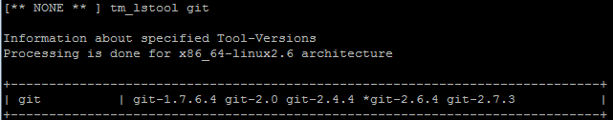
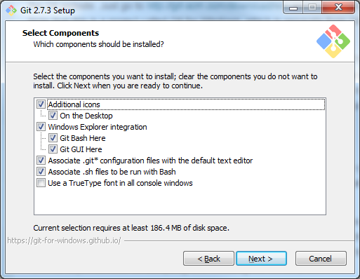
Setting up the local environment
Linux and Windows installation
On Linux
In the MN R&D environment MTS Team has installed GIT into WISDOM BFS.
If you have no version selected us the WISDOM command:
tm_chgenv –add git-2.7.3
On Windows
A good place to look for a Windows release is https://git-scm.com/download/win
A download of the latest Setup-Package will be started.
Follow the setup instructions & complete the installation.
Notes:
Stop theoretical presentation and prepare the hands on…

Slide 18
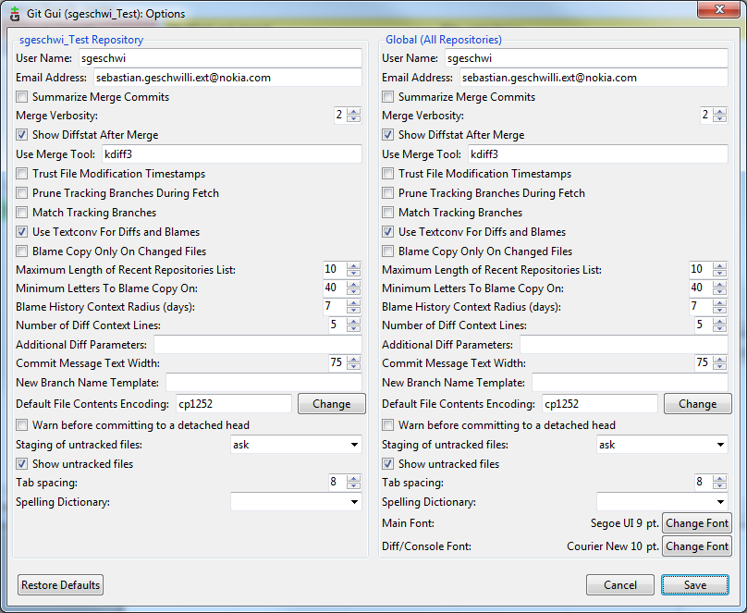
Getting started – GIT Basics!
Setting up the local environment
On LINUX
From command line “git config” is used in order to alter/setup the user settings.
git config--global user.name "your name“
git config--global user.emailyour@email.com
git config--global core.editor“path/to/editor”
Above commands are used to alter the global settings. Removing global switch will alter your settings for a single repository.
The information is stored in a text file in the user home directory “.gitconfig” which can be also manually altered.
On Windows
GIT Bash can be used the same way as in LINUX
The GIT GUI provides in the menu (Edit→Settings) a graphical interface to setup the configuration
Notes:
Mandatory configurations…
To explain why it is important: to be reminded how the commit is built.

Slide 19
Hands on GIT

Slide 20
Hands on GIT!
Create a change
For this exercise make sure that GIT is installed on the Windows machine.
Configure the username and email address with git config
git config --global user.name "your name“ git config --global user.email “your@email.com”
Start the GIT Bash command line tool from the Start menu.
Choose a path to store the Repository for this training:
sgeschwi@FRVILN0XSGESCHW MINGW64 ~ $ pwd /c/Users/sgeschwi sgeschwi@FRVILN0XSGESCHW MINGW64 ~ $ mkdir training sgeschwi@FRVILN0XSGESCHW MINGW64 ~ $ cd training
Within the directory use the “git init <name>” command to create a new Repository:
sgeschwi@FRVILN0XSGESCHW MINGW64 ~/training $ git init localrepo Initialized empty Git repository in C:/Users/sgeschwi/training/localrepo/.git/
After creation the user should see:
sgeschwi@FRVILN0XSGESCHW MINGW64 ~/training $ ls –alh total 20K drwxr-xr-x 1 sgeschwi 1049089 0 Mar 17 08:08 ./ drwxr-xr-x 1 sgeschwi 1049089 0 Mar 17 08:06 ../ drwxr-xr-x 1 sgeschwi 1049089 0 Mar 17 08:08 localrepo/ sgeschwi@FRVILN0XSGESCHW MINGW64 ~/training $ cd localrepo/
sgeschwi@FRVILN0XSGESCHW MINGW64 ~/training/localrepo (master)
Creating a new file is simple; using the preferred text-editor and saving the file in the “training/localrepo” folder.
Using “git status” command to check on the repository, GIT will explain that an untracked file is created. Use next “git add <filename>”.
Again executing “git status” shows now that the file is prepared for the next commit. Executing “git commit” to finally add the new file.
Executing once more “git status” will show “nothing to commit”

Slide 21
Hands on GIT!
GIT Help
In the first days users will need some help with the usage and may be looking for certain command explanation.
The internet is a good place to start investigations and look for answers.
But hey, we said earlier: “GIT is a distributed VC Tool. What if I am not online currently?”
Users can make use of the command line by typing:
sgeschwi@FRVILN0XSGESCHW MINGW64 ~/training/localrepo (master) $ git help
Look at the commands we have been using earlier by typing:
git help add git help commit git help status git help log
Pushing the envelop!
All too easy so far? Send the trainer an email and explain what the MASTER in this case means:
sgeschwi@FRVILN0XSGESCHW MINGW64 ~/training/localrepo (master)
What is that?

Slide 22


Slide 23
COPYRIGHT AND CONFIDENTIALITY
The contents of this document are proprietary and confidential property of Nokia. This document is provided subject to confidentiality obligations of the applicable agreement(s).
This document is intended for use of Nokia’s customers and collaborators only for the purpose for which this document is submitted by Nokia. No part of this document may be reproduced or made available to the public or to any third party in any form or means without the prior written permission of Nokia. This document is to be used by properly trained professional personnel. Any use of the contents in this document is limited strictly to the use(s) specifically created in the applicable agreement(s) under which the document is submitted. The user of this document may voluntarily provide suggestions, comments or other feedback to Nokia in respect of the contents of this document ("Feedback"). Such Feedback may be used in Nokia products and related specifications
or other documentation. Accordingly, if the user
of this document gives Nokia Feedback on the contents of this document, Nokia may freely use, disclose, reproduce, license, distribute and
otherwise commercialize the feedback in any
Nokia product, technology, service, specification
or other documentation.
Nokia operates a policy of ongoing development. Nokia reserves the right to make changes and improvements to any of the products and/or services described in this document or withdraw this document at any time without prior notice.
The contents of this document are provided "as is". Except as required by applicable law, no warranties of any kind, either express or implied, including, but not limited to, the implied warranties of merchantability and fitness for a particular purpose, are made in relation to the accuracy, reliability or contents of this document. NOKIA SHALL NOT BE RESPONSIBLE IN ANY EVENT FOR ERRORS IN THIS DOCUMENT or for any loss of data or income or any special, incidental, consequential, indirect or direct damages howsoever caused, that might arise from the use of this document or any contents of this document.
This document and the product(s) it describes are protected by copyright according to the applicable laws.
Nokia is a registered trademark of Nokia Corporation. Other product and company names mentioned herein may be trademarks or trade names of their respective owners.
© Nokia 2014

